Slide 1
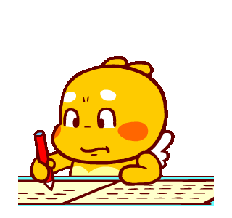

Slide 3
1. at ad
2. pen pet
3. lid dig

Slide 4
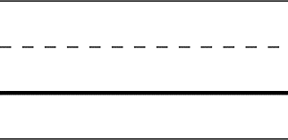
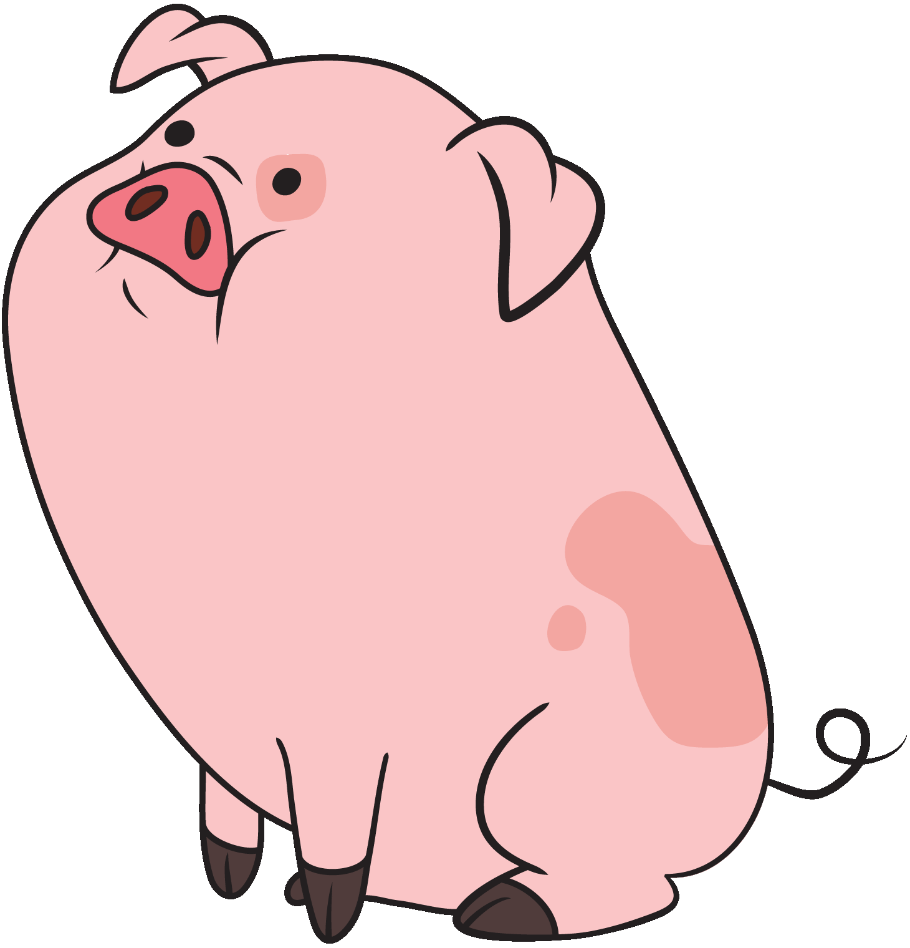
1. t
e n
2. p
i g

Slide 5
3 | 1 | 2
2 | 4 | 3 | 1

Slide 6
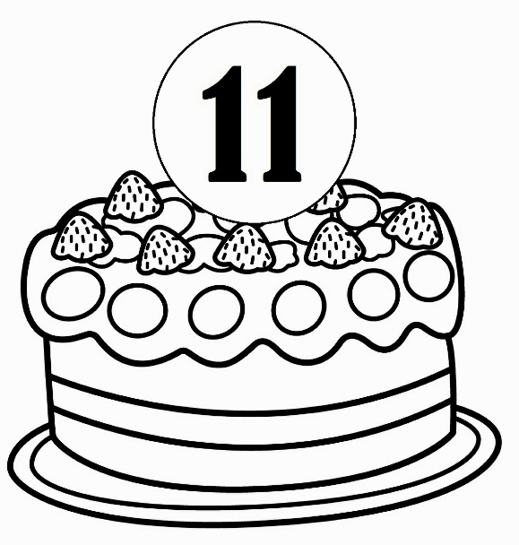
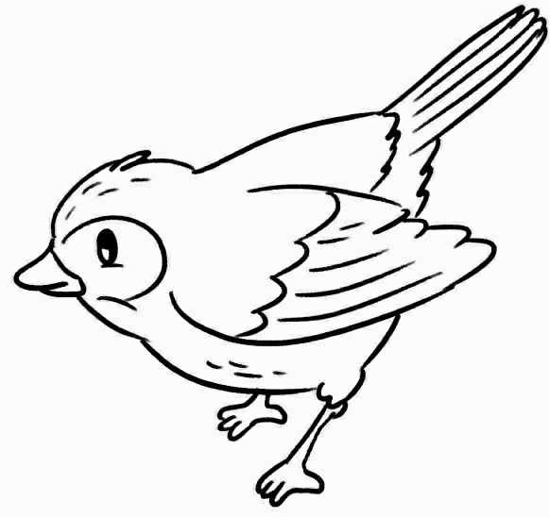
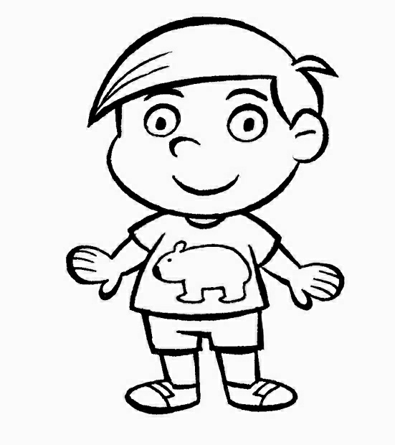
X
O
X

Slide 7
2
4
1
3

Slide 8
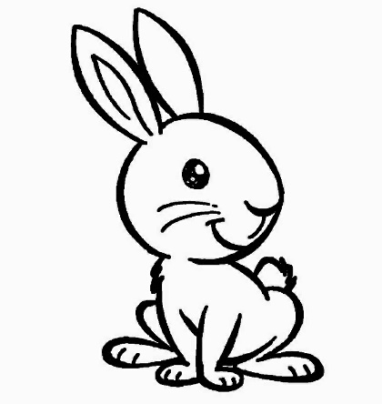
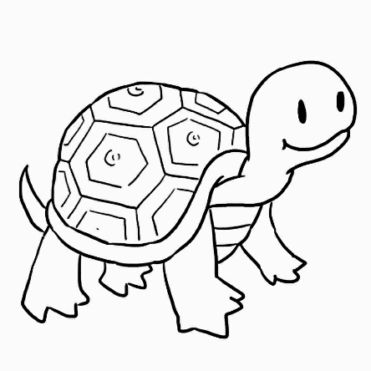
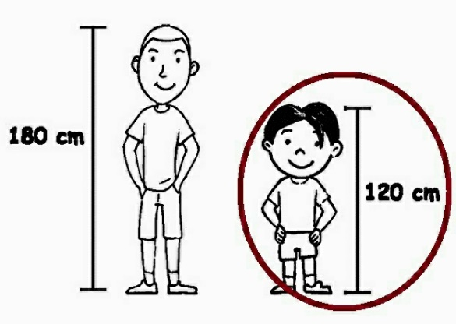
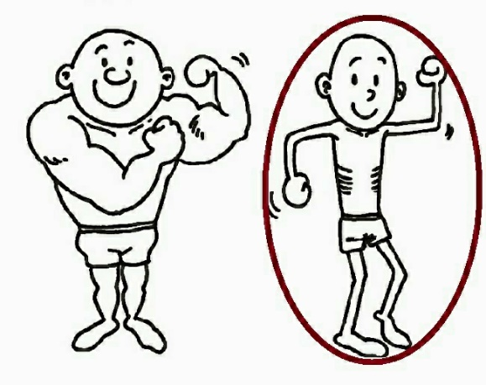
thin | short | fish | rabbit | turtle

Slide 9
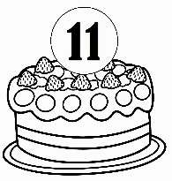
.
.
 |  | six
 |  | eight
 |  | seven
 |  | eleven
.
.
.
.
.
.

Slide 10
Are you a rabbit?
Yes, I am. I’m a rabbit.
No, I’m not. I’m a turtle.
V

Slide 11
t a l l

Slide 12
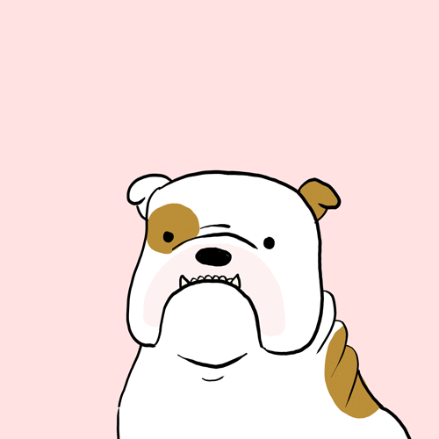
No Yes isn’t tall boy
Is it a dog?
Yes
, it is.

Slide 13
